Slide 1

Optimization Algorithms
Mini-batch
gradient descent
deeplearning.ai

Slide 2
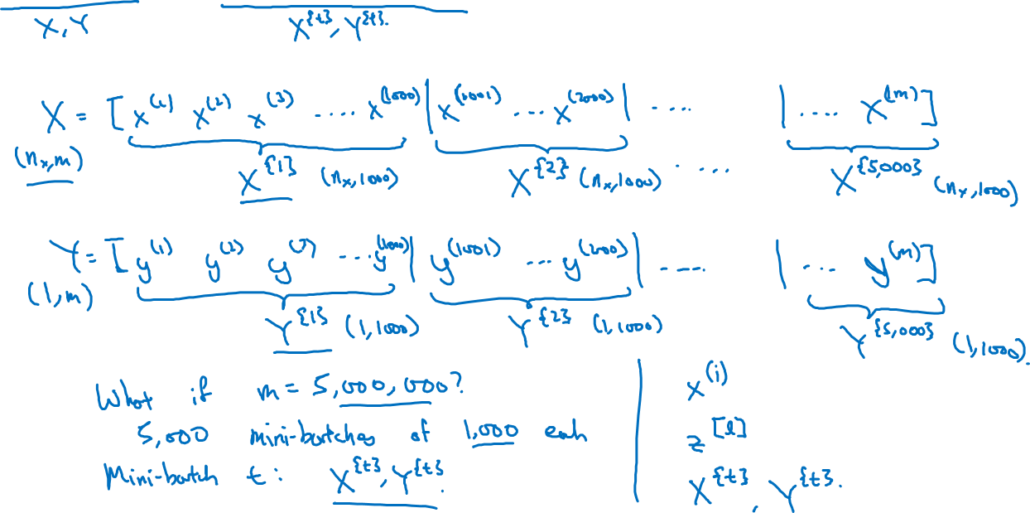
Batch vs. mini-batch gradient descent
Vectorization allows you to efficiently compute on m examples.
i training example
Layer of nuro network
Mini batches

Slide 3
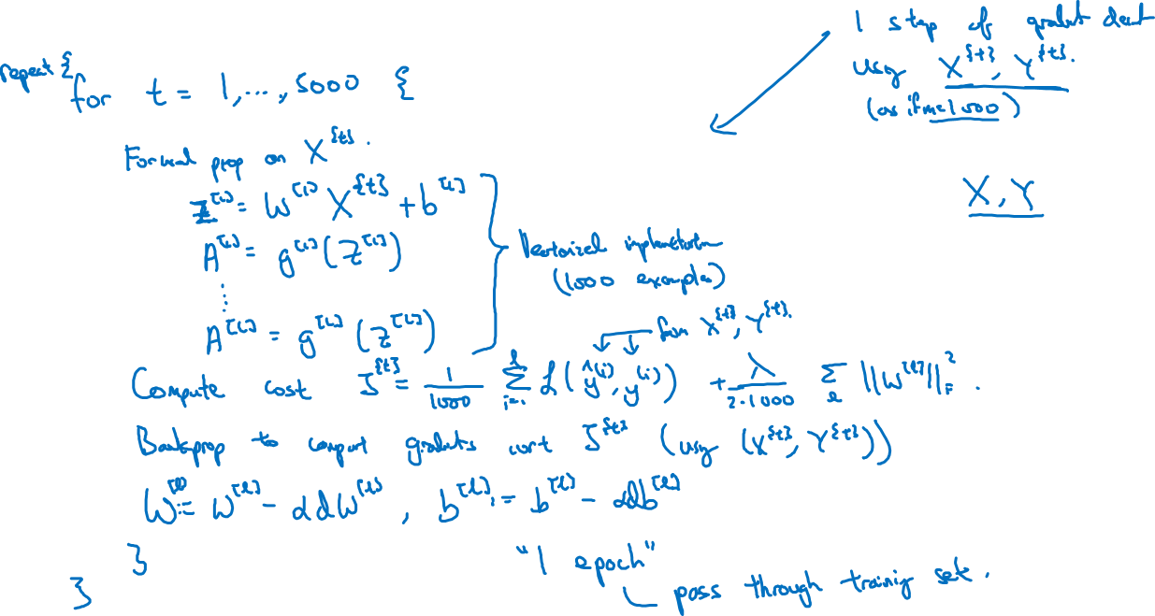
Mini-batch gradient descent

Slide 4
Optimization Algorithms
Understanding
mini-batch
gradient descent
deeplearning.ai

Slide 5
Training with mini batch gradient descent
Batch gradient descent
Mini-batch gradient descent
cost
cost
# iterations
mini batch # (t)

Slide 6
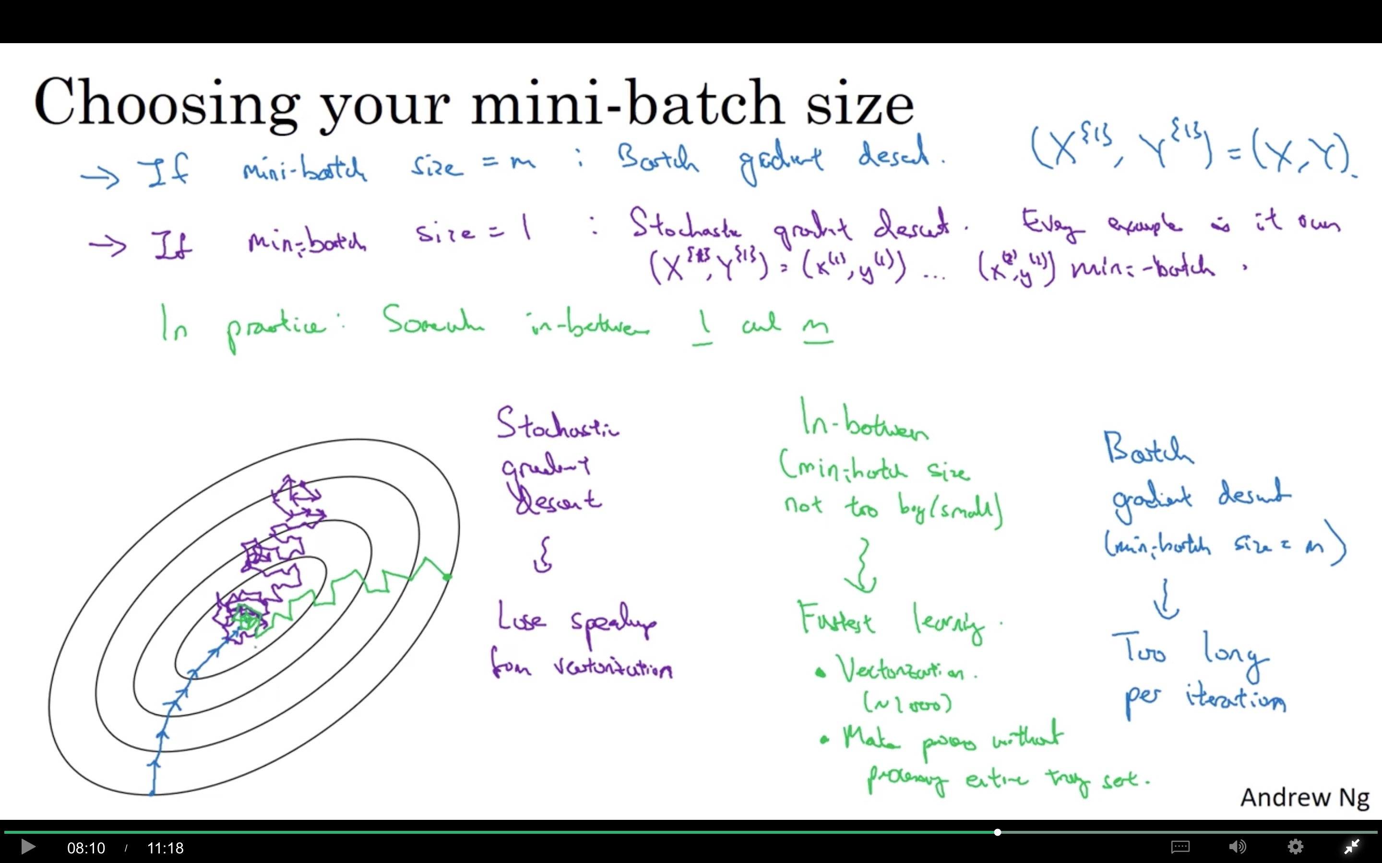

Slide 7
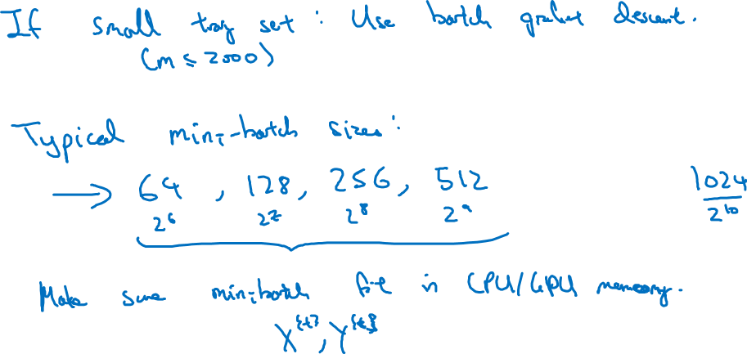
Choosing your mini-batch size

Slide 8
Optimization Algorithms
Exponentially weighted averages
deeplearning.ai

Slide 9
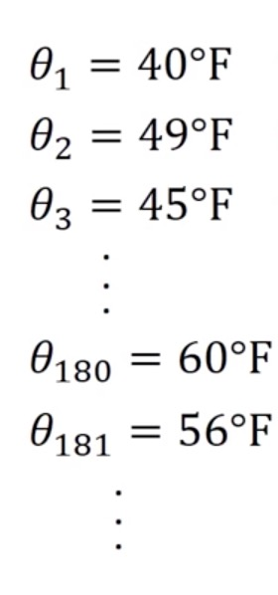
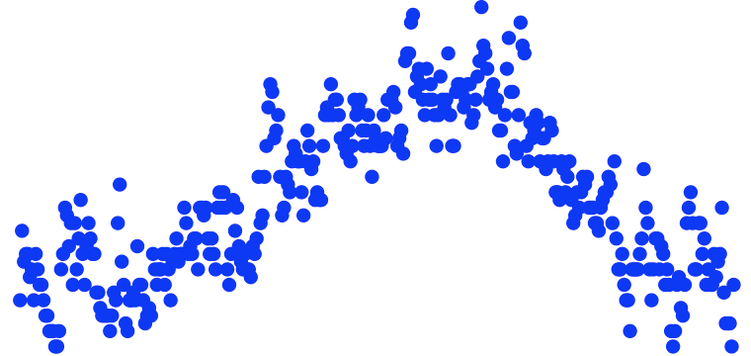
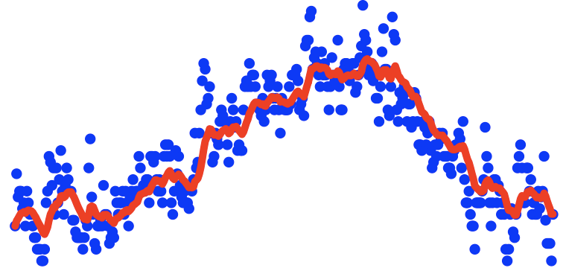


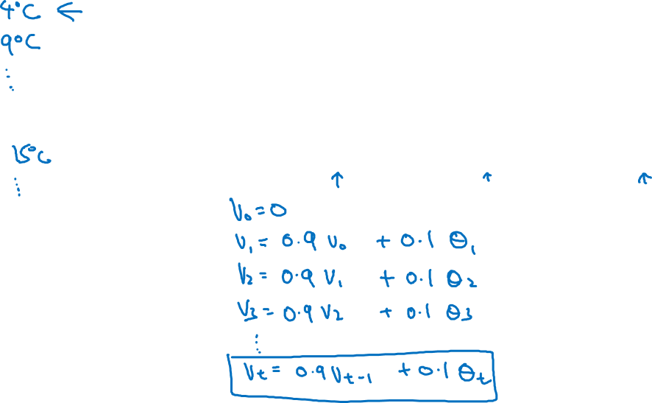
Temperature in London
$$θ_{1}=40°F$$
$$θ_{2}=49°F$$
$$θ_{3}=45°F$$
temperature
.
.
.
$$θ_{180}=60°F$$
$$θ_{181}=56°F$$
days
.
.
.

Slide 10
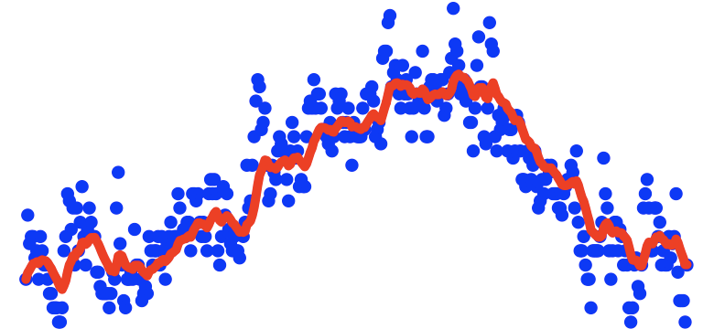
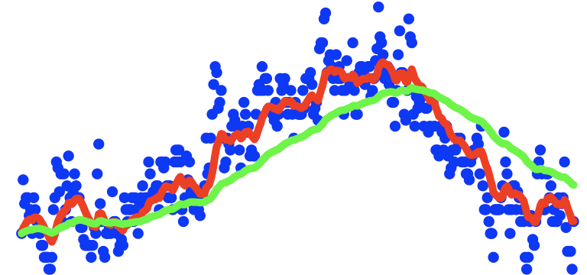
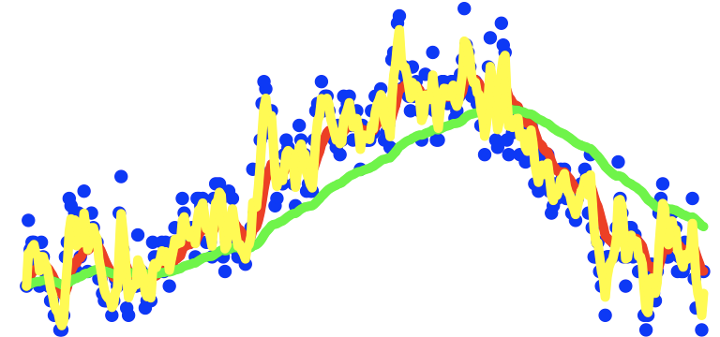
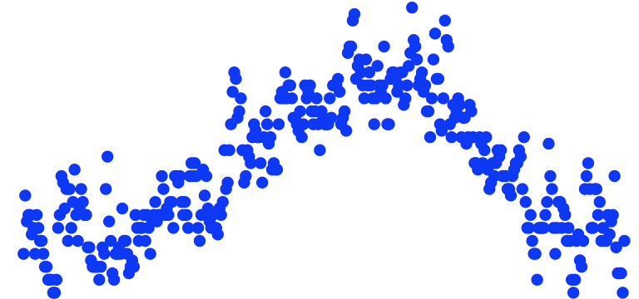
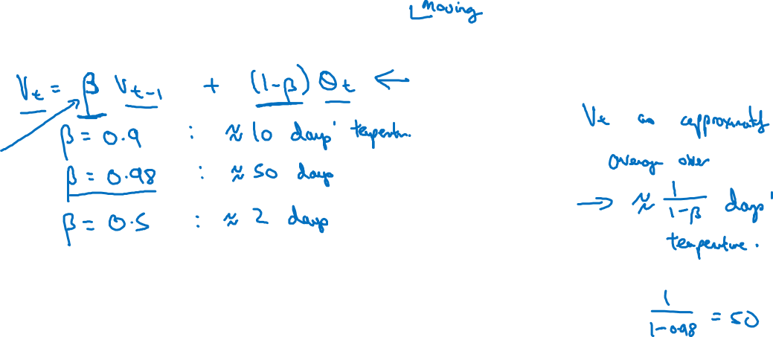
Exponentially weighted averages
Green: 0.98, shift right, flat
Red: 0.9
YellowL 0.5, oscillations
temperature
days

Slide 11
Optimization Algorithms
Understanding exponentially weighted averages
deeplearning.ai

Slide 12
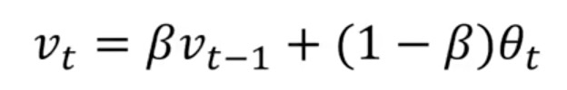
Exponentially weighted averages
$$v_{t}=βv_{t−1}+(1−β)θ_{t}$$
temperature
days

Slide 13
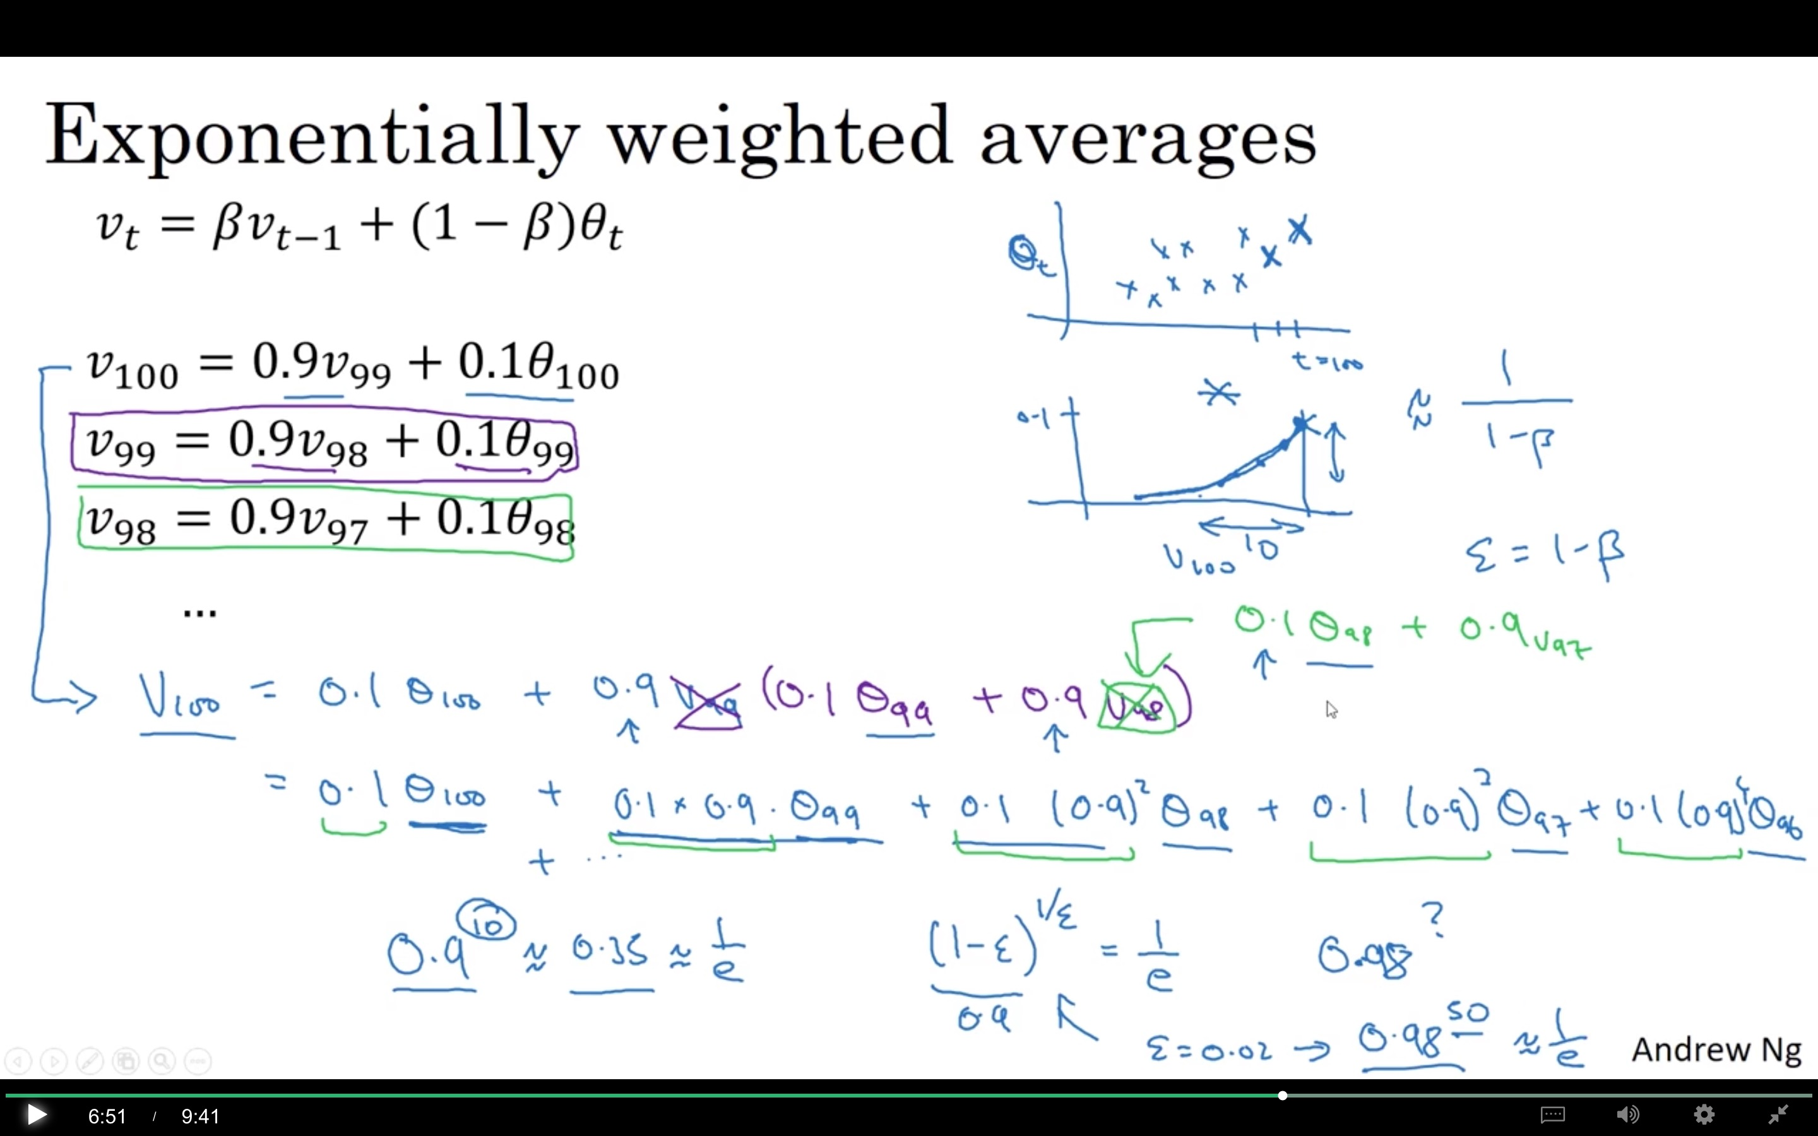

Slide 14
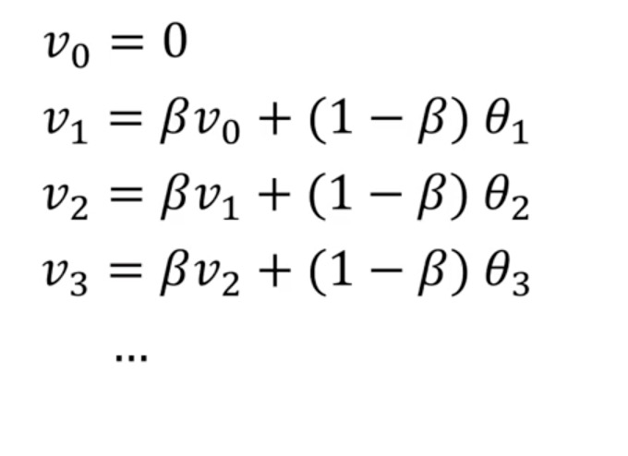




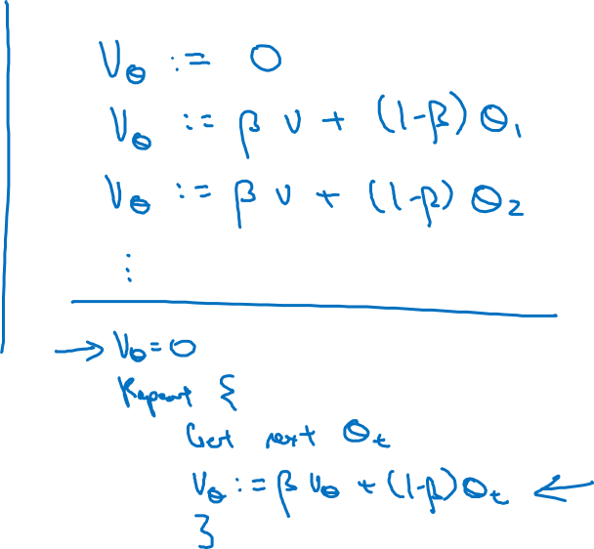
Implementing exponentially weighted averages
$$v_{0}=0$$
$$v_{1}=βv_{0}+(1−β) θ_{1}$$
$$v_{2}=βv_{1}+(1−β) θ_{2}$$
$$v_{3}=βv_{2}+(1−β) θ_{3}$$
$$…$$

Slide 15
Optimization Algorithms
Bias correction
in exponentially
weighted average
deeplearning.ai

Slide 16
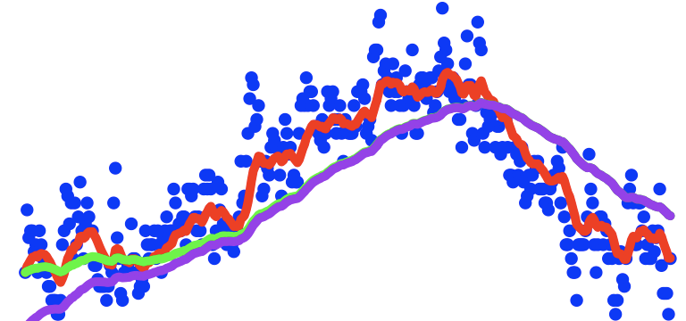
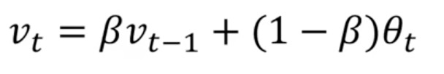
Bias correction
temperature
Why not use average of first 1/(1-beta) data as initial?
days
$$v_{t}=βv_{t−1}+(1−β)θ_{t}$$

Slide 17
Optimization Algorithms
Gradient descent with momentum
deeplearning.ai

Slide 18
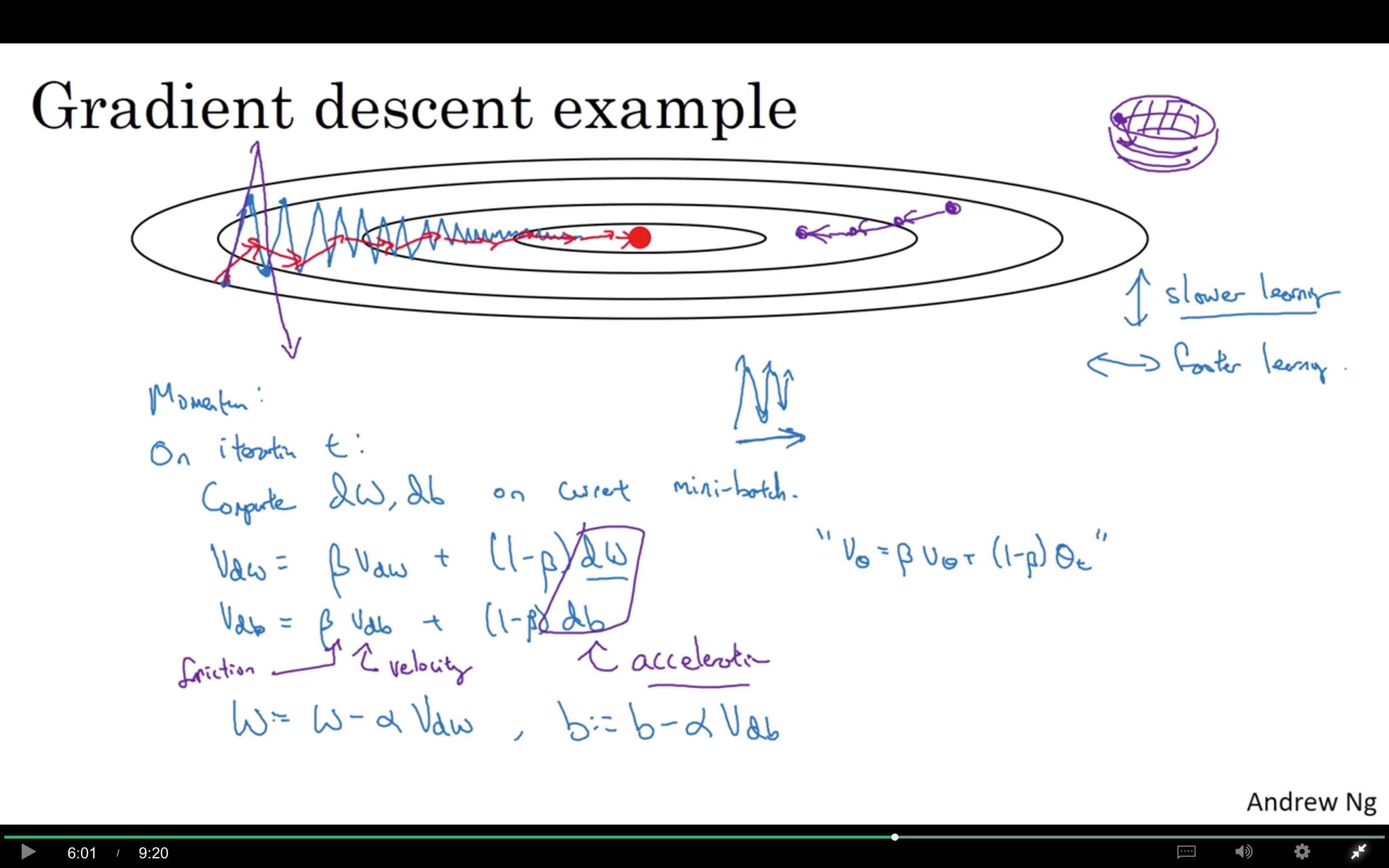
Why not do normalization?
After normalize data, in mini batch we still have variation. Any other reasons?

Slide 19
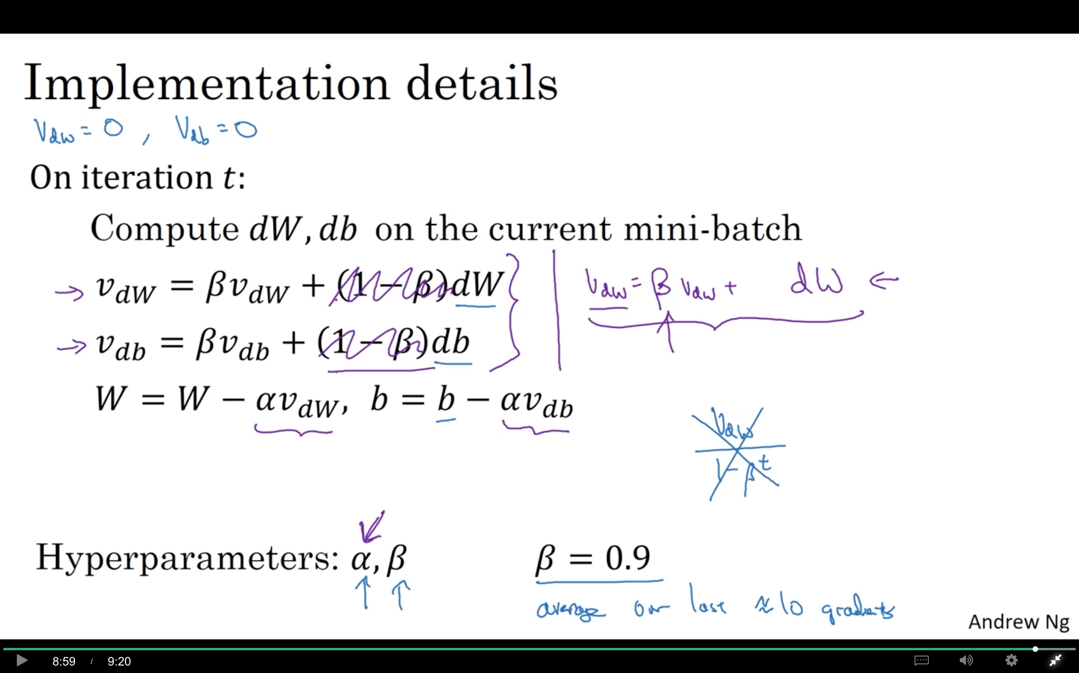

Slide 20
Optimization Algorithms
RMSprop
deeplearning.ai

Slide 21
RMSprop

Slide 22
Optimization Algorithms
Adam optimization
algorithm
deeplearning.ai

Slide 23
Adam optimization algorithm

Slide 24

Hyperparameters choice:
Adam Coates

Slide 25
Optimization Algorithms
Learning rate
decay
deeplearning.ai

Slide 26
Learning rate decay

Slide 27
Learning rate decay

Slide 28
Other learning rate decay methods

Slide 29
Optimization Algorithms
The problem of
local optima
deeplearning.ai

Slide 30
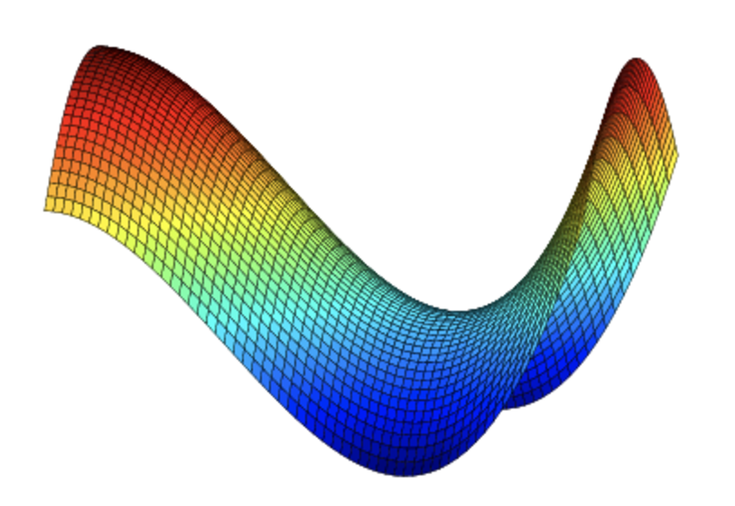
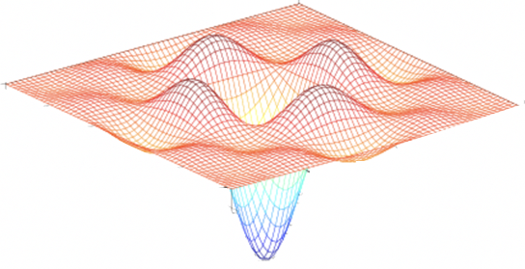
Local optima in neural networks

Slide 31

Problem of plateaus
Unlikely to get stuck in a bad local optima
Plateaus can make learning slow

